Slide 1
Fundamentals of Computer Networks and Management
Atul Kahate

Slide 2
Sessions 1 and 2

Slide 3
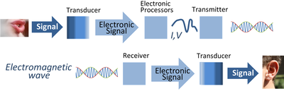
Electronic Communication System

Slide 4
Introduction to Communication System
Communication system allows exchange of data between two stations, transmitter and receiver
Signals pass from source to destination through what is called channel, which represents a way that signal use it to move from source toward destination
To transmit signals in communication system, it must be first processed in several stages, beginning from signal representation, to signal shaping until encoding and modulation
After preparing the transmitted signal, it is passed to the transmission line of channel
Due to the signal crossing this media it faces many impairments such as noise, attenuation and distortion

Slide 5
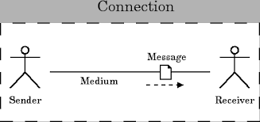
Components of a Data Communication System
Transmission device or Sender
A device that actually sends out the message.(eg computer , telephone, etc).
A medium
A physical channel where the information travels from the sender to the receiver.
Message
The data/information to be transmitted. It can be in the form of text, audio, video, photos, or combination of them.
Receiving device or Receiver
A device that receives the message then process the information in the message.

Slide 6
Issues in Computer Networking
Sharing computer resources
Interaction between computers
Network applications
Physical data transmission
Encoding
Physical link characteristics
Interaction among several computers
Topology
Addressing
Switching

Slide 7
Network Hardware and Software
Two types of transmission technology: Broadcast links and Point-to-point links
Broadcast network
The communication channel is shared by all the machines on the network
Packets sent by any machine are received by all the others.
An address field within each packet specifies the intended recipient.
A wireless network is a common example of a broadcast
Point-to-point network
Links connect individual pairs of machines
Point-to-point transmission with exactly one sender and exactly one receiver is sometimes called unicasting

Slide 8
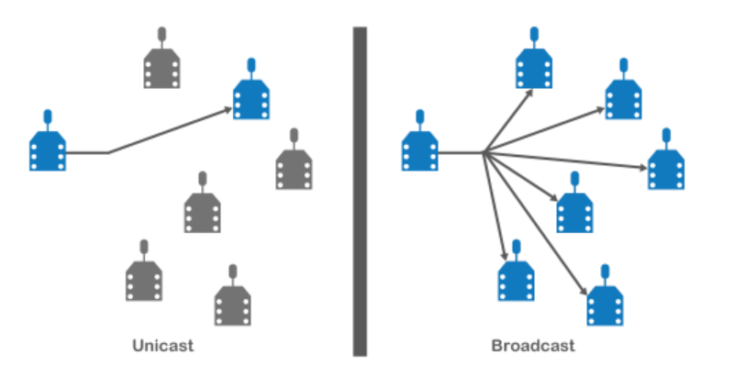
Unicast versus Broadcast

Slide 9
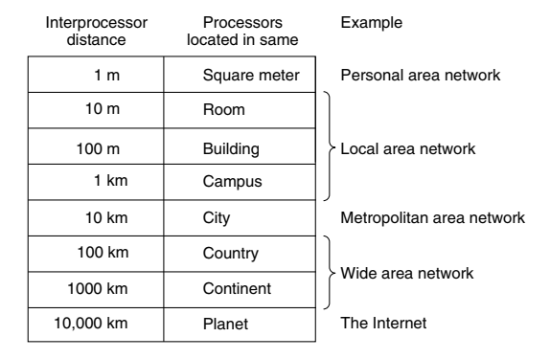
Scale and Network Types

Slide 10
Local Area Network (LAN)
Local Area Network (LAN): A privately owned network that operates within a single building like a home, office or factory
Wireless LANs: In these systems, every computer has a wireless modem and an antenna that it uses to communicate with other computers
An access point or base station controls the network
IEEE 802.11 standard (also called WiFi) describes this

Slide 11
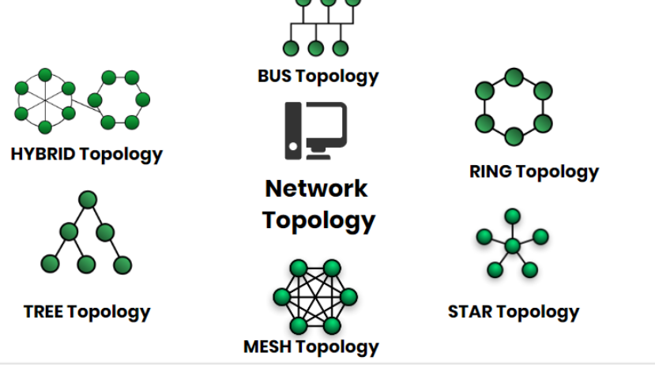
Network Topology
Network Topology represents a network arrangement consisting of several nodes

Slide 12
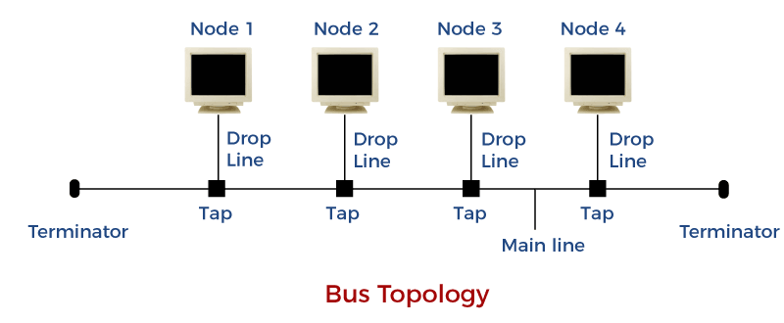
Bus Topology
All the nodes are connected to a common wire, called as bus
Simple and cost-effective, but all depends on a single cable, not fast

Slide 13
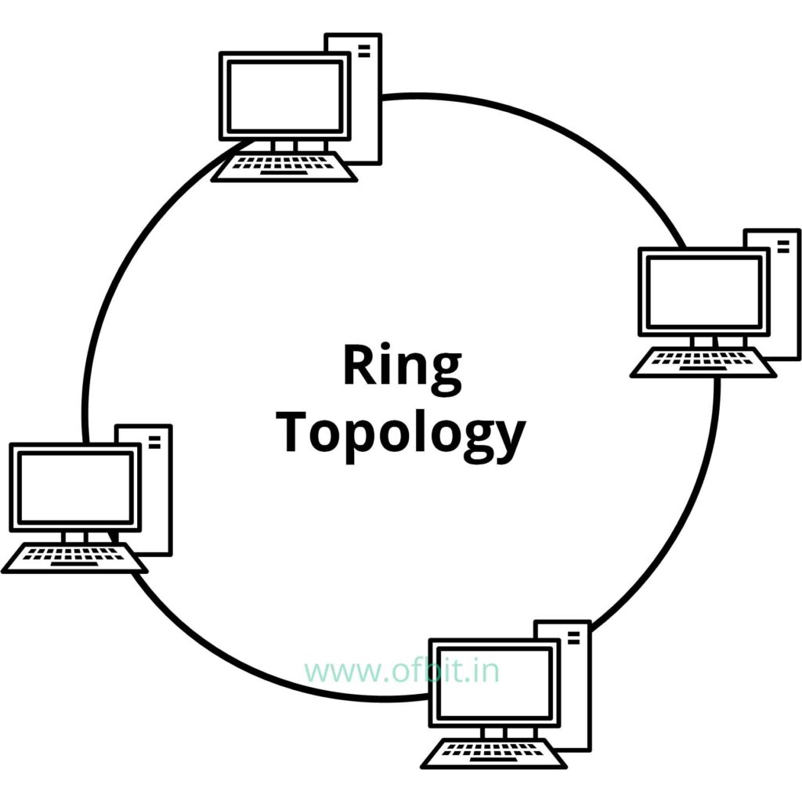
Ring Topology
One computer is connected to the next, and so on, to complete a ring
A transmitting computer needs to have a token, before transmitting
Inexpensive, Tough to add or remove nodes, One node crashing can disconnect the whole network

Slide 14
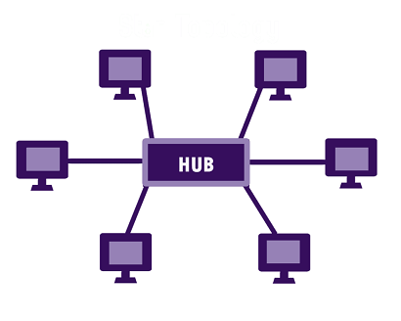
Star Topology
Each device is connected to a central hub
All communication goes through the hub only
Simple, too much of dependence on the hub, but the hub can be upgraded easily, Easy to troubleshoot, Cost is high

Slide 15
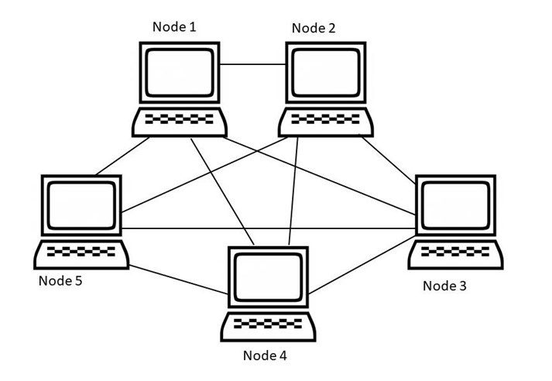
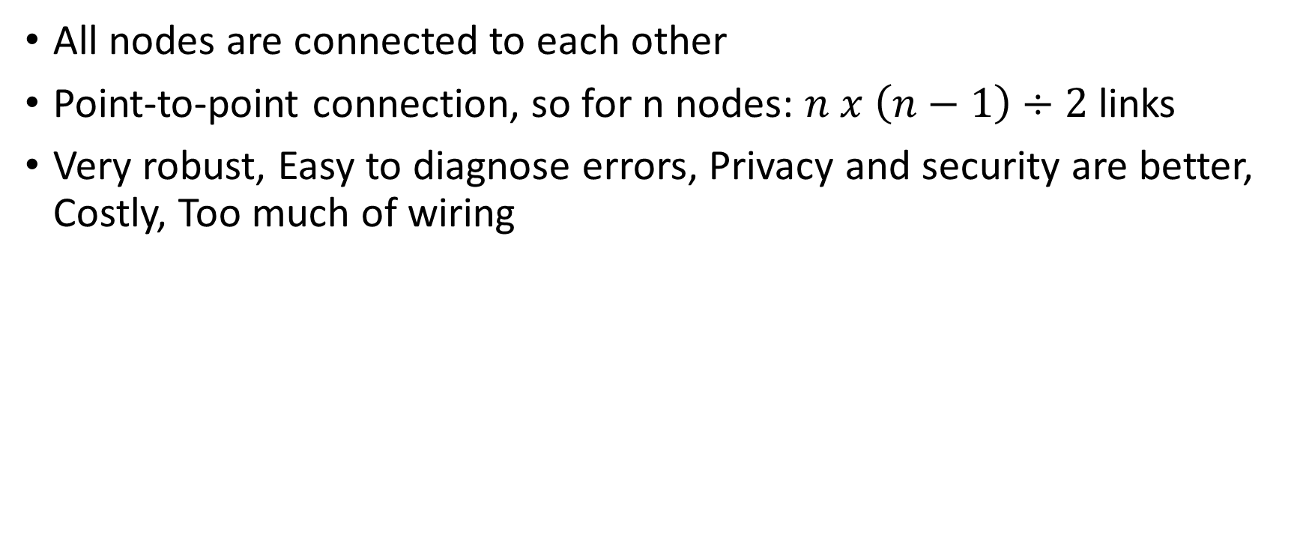
Mesh Topology
All nodes are connected to each other
Point-to-point connection, so for n nodes: $n x \left(n−1\right)÷2$ links
Very robust, Easy to diagnose errors, Privacy and security are better, Costly, Too much of wiring

Slide 16
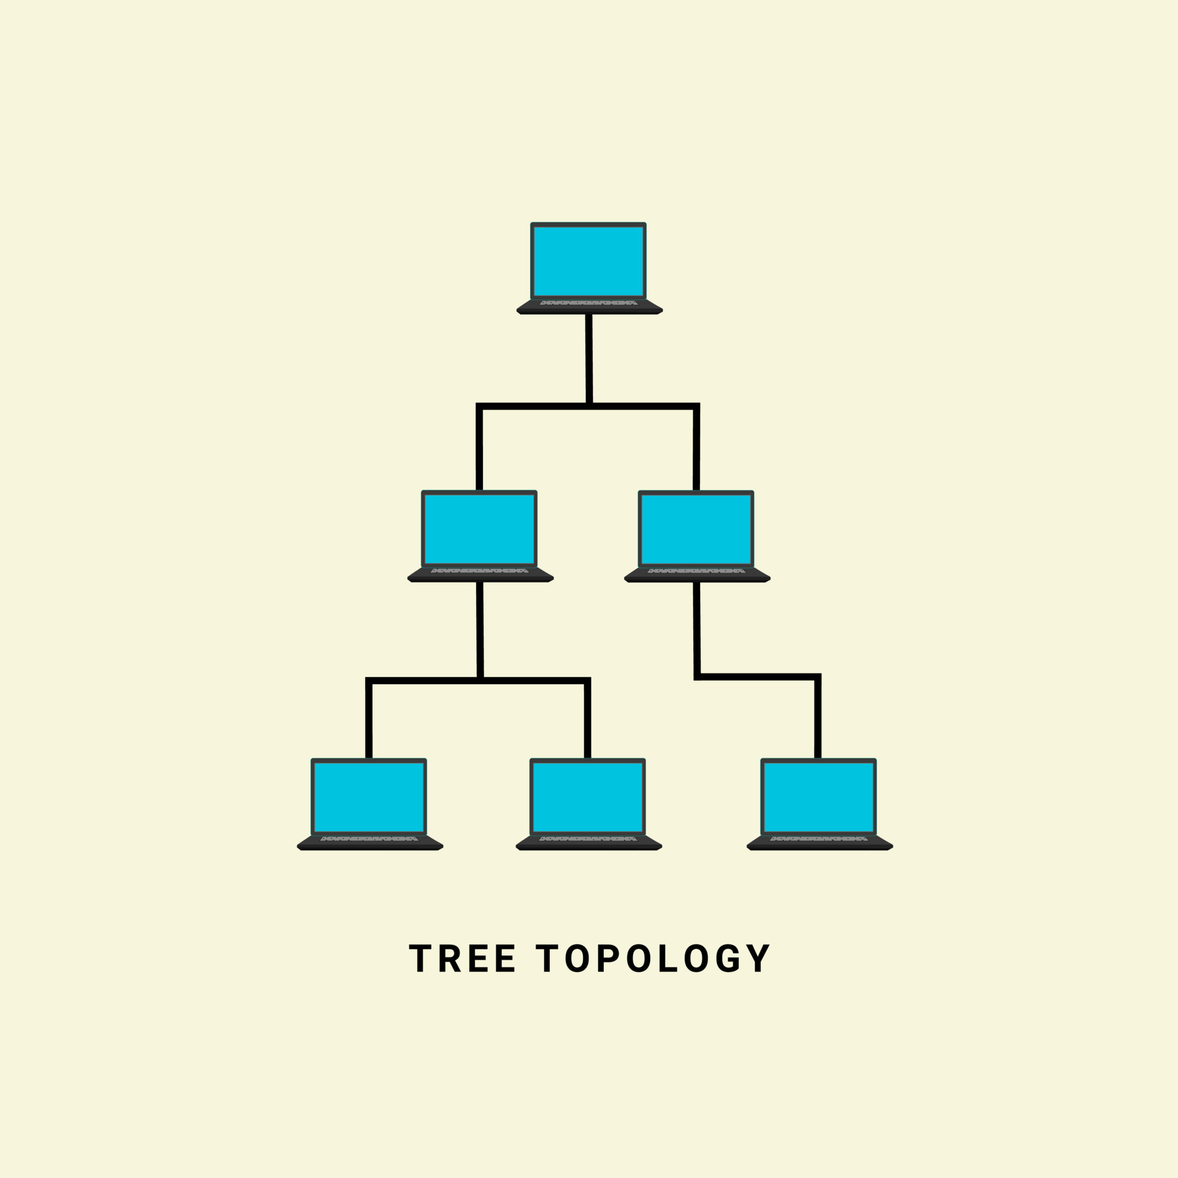
Tree Topology
Nodes are connected hierarchically, ultimately connecting to the top node, called as the root node
Has at least three levels of hierarchy
Easy to expand and manage, debug
Expensive, lot of cabling

Slide 17
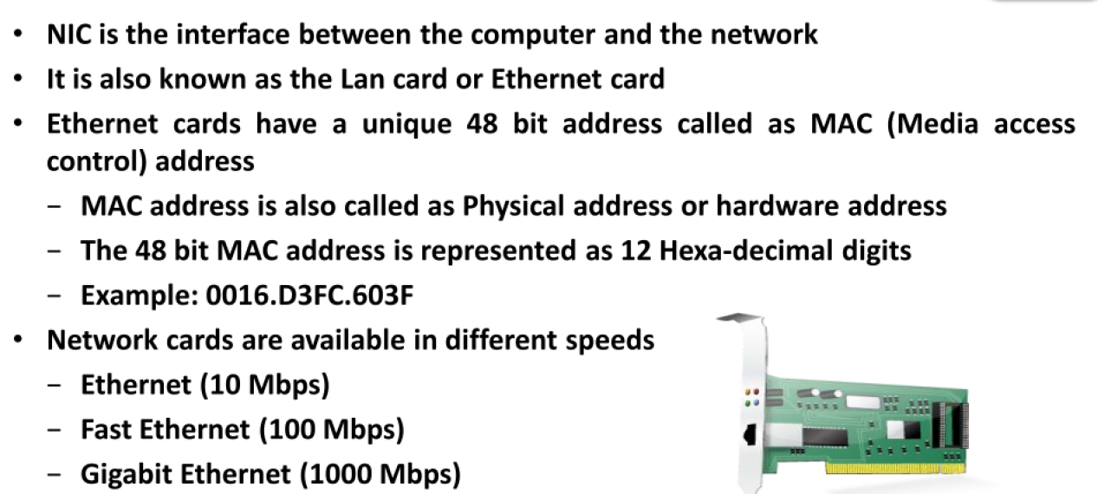
Network Interface Card (NIC)

Slide 18
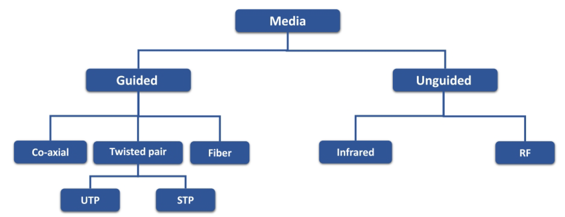
Transmission media

Slide 19
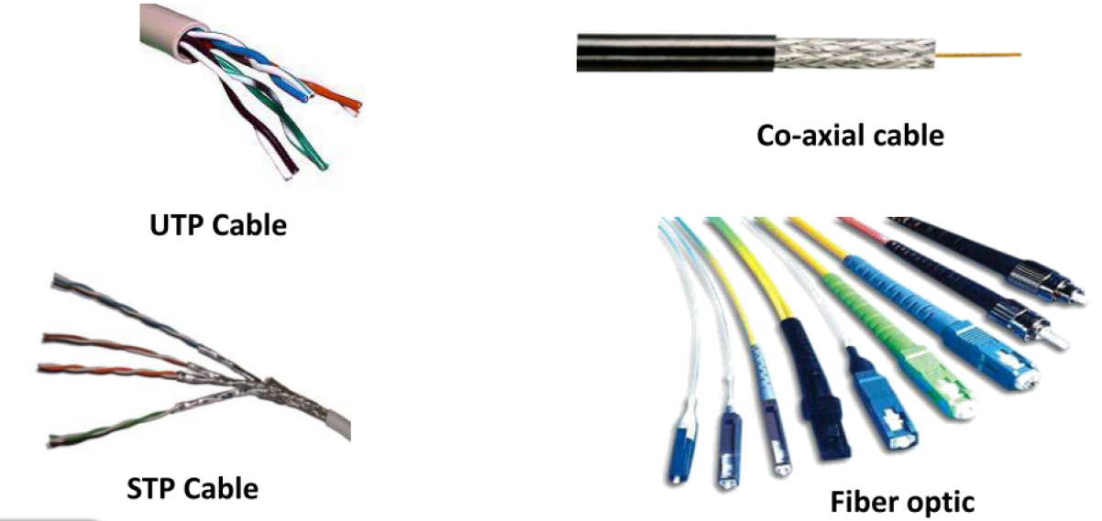
Transmission media

Slide 20
Transmission Media
Transmission medium: Carries information from a source to a destination
Guided media (Wired) include twisted-pair cable (uses electric current), coaxial cable (uses electric current), fiber-optic cable (uses light)
Unguided medium (Wireless) is air

Slide 21
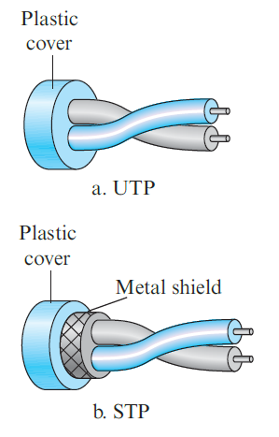
Twisted-pair cable
Consists of two copper wires
Two types
Unshielded twisted-pair (UTP)
Shielded twisted-pair (STP)
Used in telephone networks

Slide 22
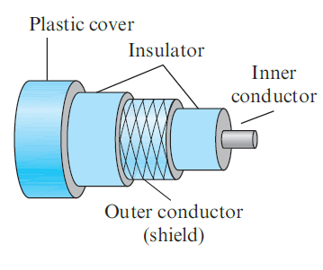
Coaxial cables
Coaxial cable (or coax) carries signals of higher frequency ranges than those in twisted-pair cable
Instead of having two wires, coax has a single copper wire
Usage: Telephone, Cable TV, LAN

Slide 23
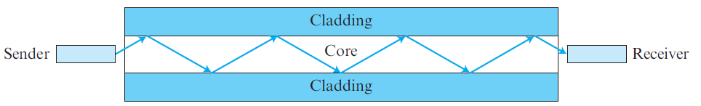
Fiber-optic cable
Made of glass or plastic and transmits signals in the form of light
Modern Ethernet is fiber optic-based

Slide 24
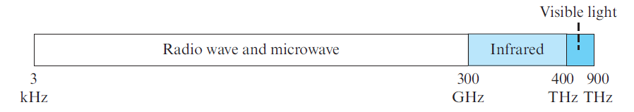
Unguided media
Use electromagnetic waves – no wire is needed
Also called as wireless communication
Signals are normally broadcast through free space and thus are available to anyone who has a device capable of receiving them
The part of the electromagnetic spectrum, ranging from 3 kHz to 900 THz is used for wireless communication.

Slide 25
Ethernet
Most popular LAN technology
Earlier, we also had Token Ring, Token Bus, etc
Ethernet generations
Standard Ethernet (10 Mbps)
Fast Ethernet (100 Mbps)
Gigabit Ethernet (1 Gbps)
10 Gigabit Ethernet (10 Gbps)

Slide 26
Earlier Ethernet – Classic Ethernet
Carrier sense multiple access with collision detection (CSMA/CD) technique was used
Allow any host to send data
If two hosts transmit at the same time, collision happens
They recover using CSMA/CD

Slide 27
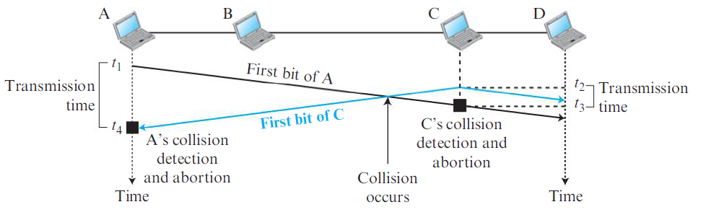
CSMA/CD

Slide 28
Modern Ethernet: Switched Ethernet
Devices called switches are used to connect different computers
Classic Ethernet is the original form and ran at rates from 3 to 10 Mbps
Switched Ethernet
Fast Ethernet: 100 Mbps
Gigabit Ethernet: 1000 Mbps (1 Gbps)
10 Gigabit Ethernet: 10,000 Mbps (10 Gbps)
In practice, only switched Ethernet is used nowadays

Slide 29
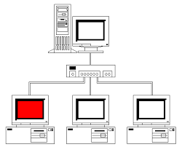
Switched Ethernet
Hosts connect into switches, and switches connect to each other
Ethernet switch

Slide 30
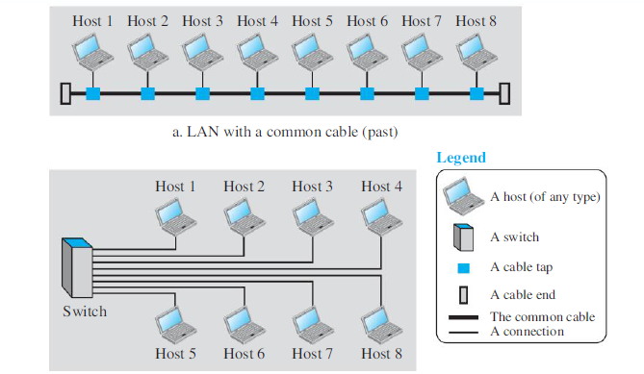
LAN – Earlier and Now

Slide 31
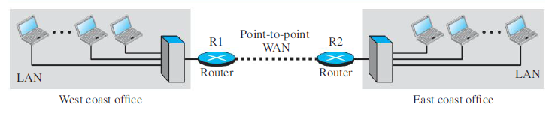
Wide Area Network (WAN)
A Wide Area Network (WAN) spans a large geographical area, often a country or continent
Example: Two LANs can be connected to form a WAN

Slide 32
Sessions 3 and 4

Slide 33
Protocol
Communication between two people or two devices needs to follow some protocol
A protocol is a set of rules that governs communication
For example, in a face-to-face communication between two persons, there is a set of implicit rules in each culture that define how two persons should start the communication, how to continue the communication, and how to end the communication

Slide 34
Network Software
Network software uses a protocol stack
A protocol stack contains many layers or levels
Each layer provides some services to the layer above it
Each layer hides complexity of its work from the layer above it
Creates a protocol hierarchy

Slide 35
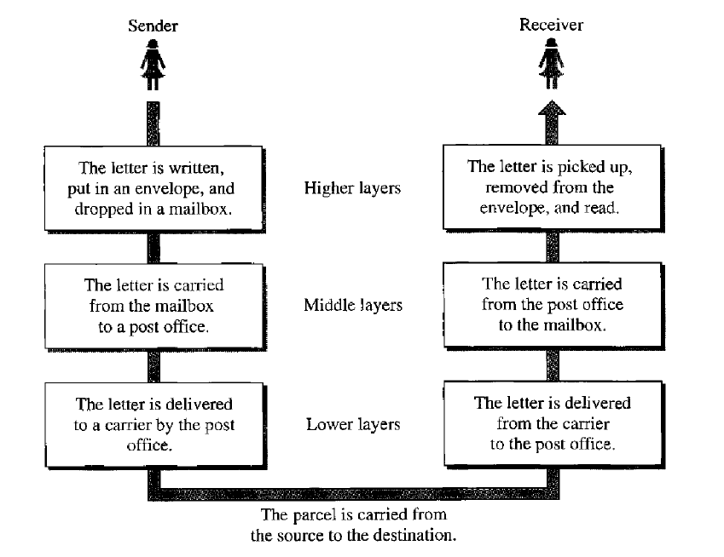
Protocol Hierarchy Example

Slide 36
OSI
Open Systems Interconnection
Good in theory, not used in practice
Contains 7 layers
Sometimes also called ISO/OSI

Slide 37
Layers in OSI
Application Layer
Presentation Layer
Session Layer
Transport Layer
Network Layer
Data Link Layer
Physical Layer
Notes:
37

Slide 38
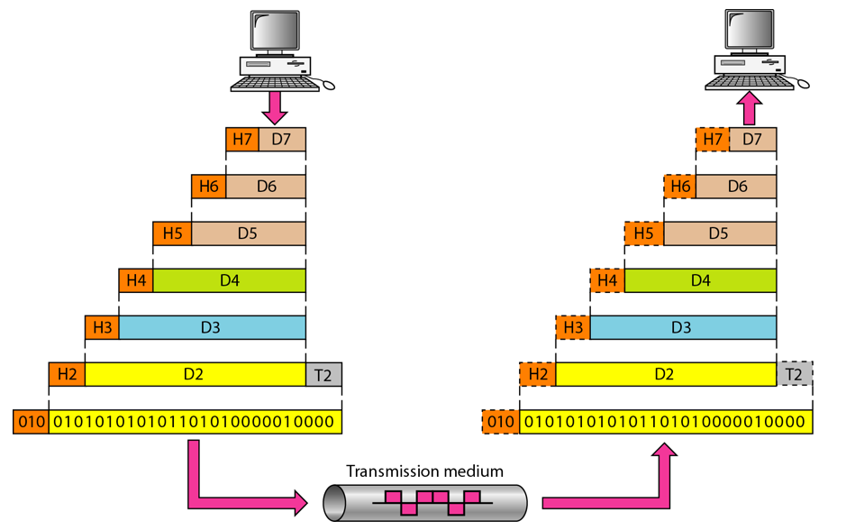
An Exchange using the OSI Model

Slide 39
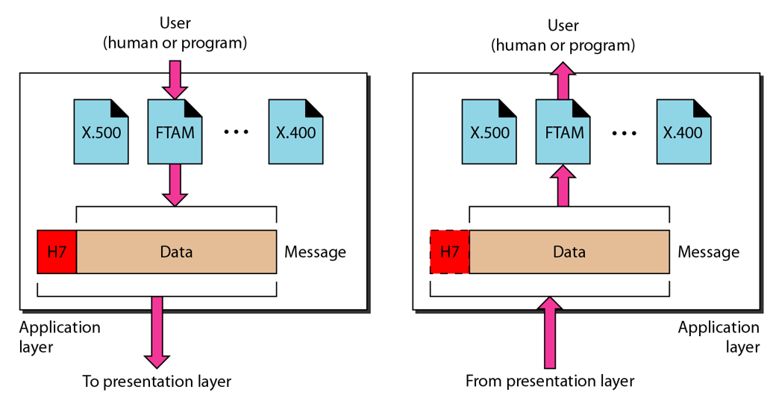
The Application Layer

Slide 40
Application Layer
Provides an “application view” to a network (e.g. email, file transmission)
Example: Hypertext Transfer Protocol (HTTP) is used to access Web pages
Encapsulation begins here
Other examples: Email (SMTP), File transfers (FTP), Querying domain names (DNS)

Slide 41
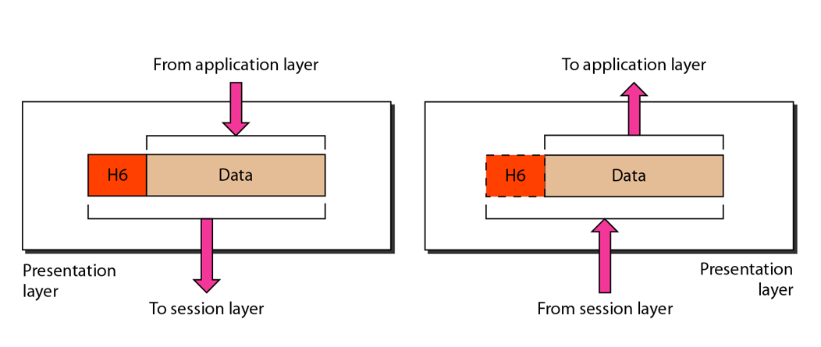
The Presentation Layer

Slide 42
Presentation Layer
Translation: Use of a common format to take care of differences (encoding, number representation etc)
Encryption: To achieve confidentiality or privacy
Compression: Reduces the number of bits needed to be transmitted

Slide 43
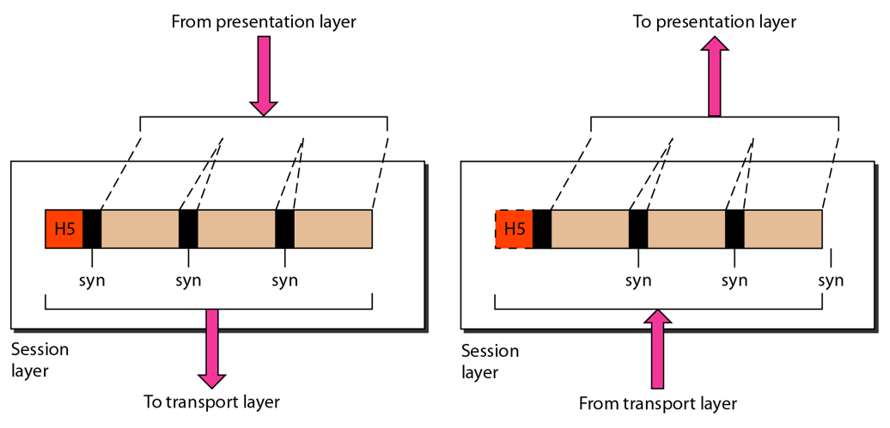
The Session Layer

Slide 44
Session Layer
Manages the session between applications
Example: Between browser of the source computer and server of the destination computer

Slide 45
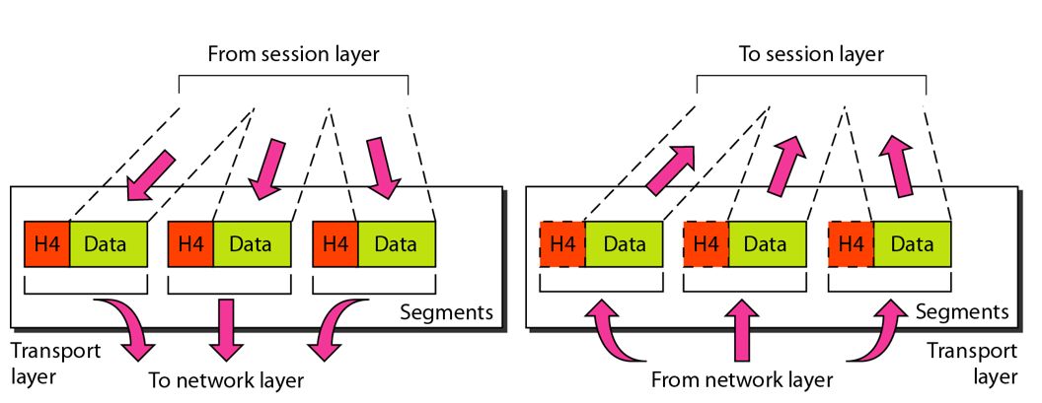
The Transport Layer

Slide 46
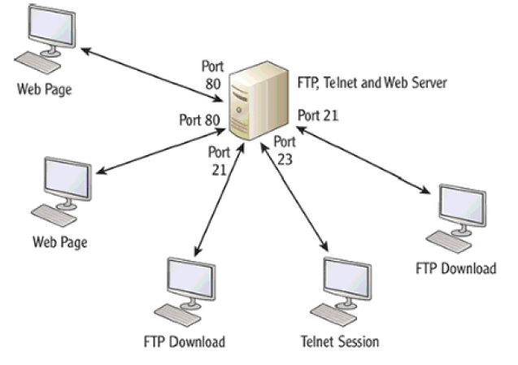
Transport Layer
Identifies the application on the destination computer using port numbers
Example: One server, multiple applications

Slide 47
Port Numbers
Port number is a 16-bit value, so it can store a number between 0 and 65,535
Port Number Range | Where used? | Called as
0-1023 | Server | Well-known ports
1024-49151 | Client | Temporary/Ephemeral
49152-65535 | NA | Dynamic, Usage-based

Slide 48
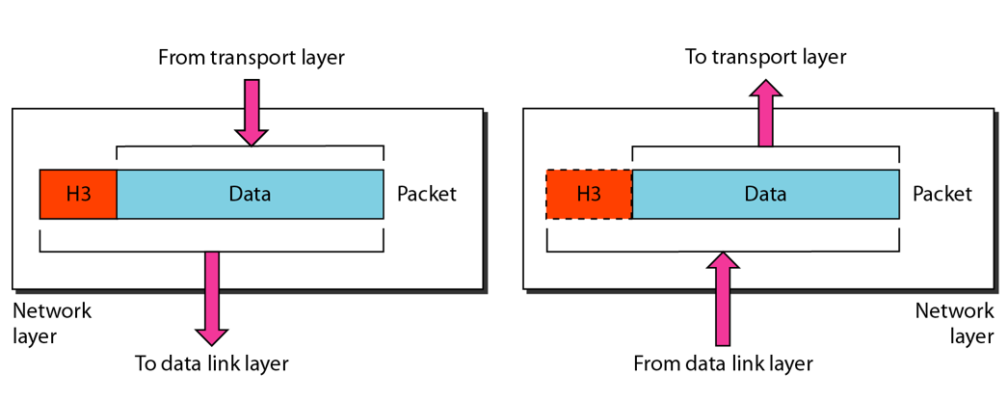
The Network Layer

Slide 49
Network Layer
Physical/MAC addresses are defined by data link layer to take care of addressing inside the same network
If a packet has to travel across a network to another network, physical addressing will not work
Hence, a universal address or a logical address is required. This is done at the network layer
This is the IP address

Slide 50
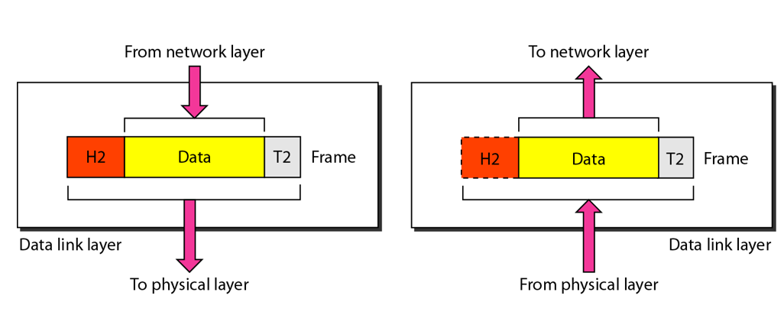
The Data Link Layer

Slide 51
Data Link Layer
Responsible for delivery of packets between two hosts connected to the same physical network (hop-to-hop – see next slide)
Cannot work across networks
Uses frames
Physical addressing: Adding sender’s and receiver’s physical addresses (also called MAC addresses) to the frame header
LAN/WAN operates at this layer (e.g. Ethernet or WiFi)
What if we know the IP address of a computer but do not know its MAC address?
Use Address Resolution Protocol (ARP)

Slide 52
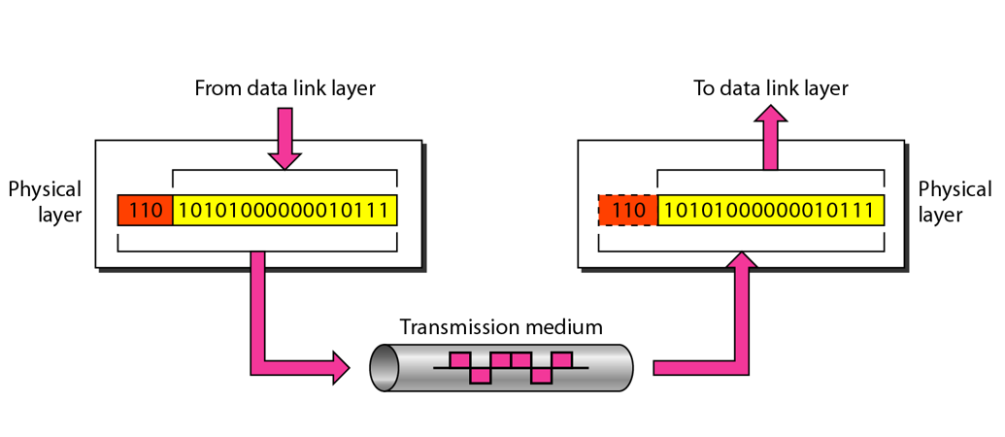
The Physical Layer

Slide 53
Physical Layer Functions
Carries the data (0s and 1s) in the form of signals
Signals can be electric, optical, or wireless

Slide 54
Physical and Logical Address
Each computer on the Internet has two addresses:
Physical address/MAC address/Hardware address
Fixed address, hardcoded on the Network Interface Card (NIC)
Different for different network type (e.g. Ethernet card, WiFi card)
Useful within or inside a network only
Logical address/IP address/Virtual address
Exists in software
Given by the network provider or your organization (usually temporary)
Useful outside a network (e.g. to reach another computer on the Internet, anywhere in the world)

Slide 55
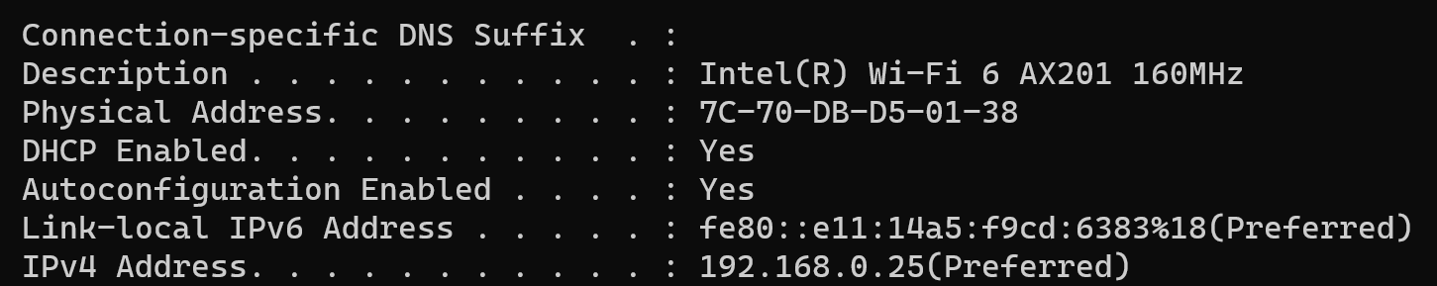
Example

Slide 56
Example
Suppose we have used our web browser to access a web page located on our company’s web server
Consider that the following are the details of the two computers
Computer | IP Address | MAC Address | Port Number
Web server | 192.168.5.1 | 5-5-5-5-5-5 | TCP 80
Laptop | 192.168.5.2 | 6-6-6-6-6-6 | TCP 5091

Slide 57
How will the Web Server Respond?
Layer 7 obtains the data in the form of the HTML document.
Layer 6 adds information about the formatting.
Layer 5 adds information required to create a session between the web server and the web browser on the laptop.
Layer 4 adds the transport protocol and the source and destination port numbers, in this case TCP (it's a unicast) and port 80 (HTTP).
Layer 3 adds the source and destination IP addresses, in this case a source of 192.168.5.1 and a destination of 192.168.5.2.
Layer 2 learns the destination MAC address and adds the source and destination MAC addresses, in this case, a source of 5-5-5-5-5-5 and destination of 6-6-6-6-6-6.
Layer 1 converts the entire package into bits and sends it across the network to the laptop.

Slide 58
How will the Laptop Handle this?
Layer 1 receives the bits in electrical format, converts them to be read by layer 2, and hands them to layer 2.
Layer 2 examines the destination MAC address to see whether it is addressed to it, sees the MAC address of 6-6-6-6-6 (its own), drops that part of the transmission, and hands the remaining data to layer 3.
Layer 3 examines the destination IP address to ensure that it is its own (192. 168.5.2), drops that part, and hands the rest of the package to layer 4.
Layer 4 examines the destination port number (port 5091), alerts the browser that HTTP data is coming in, drops that part, and hands the rest of the package to layer 5.
Layer 5 uses the information that was placed on this layer by the web server to create the session between the web server and the web browser and then hands the rest of the information to layer 6.
Layer 6 performs any format translation that may be required and hands the remaining data (the HTML document) to layer 7.
The layer 7 application (the web browser) receives the HTML document and opens the document in the browser window.

Slide 59
TCP/IP

Slide 60
Basics of TCP/IP
The TCP/IP protocol suite was developed prior to the OSI model
Therefore, the layers in the TCP/IP protocol suite do not match exactly with those in the OSI model
The original TCP/IP protocol suite was defined as four software layers built upon the hardware
Sometimes TCP/IP is thought of as a five-layer model with the layers named similarly to the ones in the OSI model

Slide 61
OSI versus TCP/IP
When we compare the two models, we find that two layers, session and presentation, are missing from the TCP/IP protocol suite
These two layers were not added to the TCP/IP protocol suite after the publication of the OSI model
The application layer in the suite is usually considered to be the combination of three layers in the OSI model
See diagram on the next slide

Slide 62
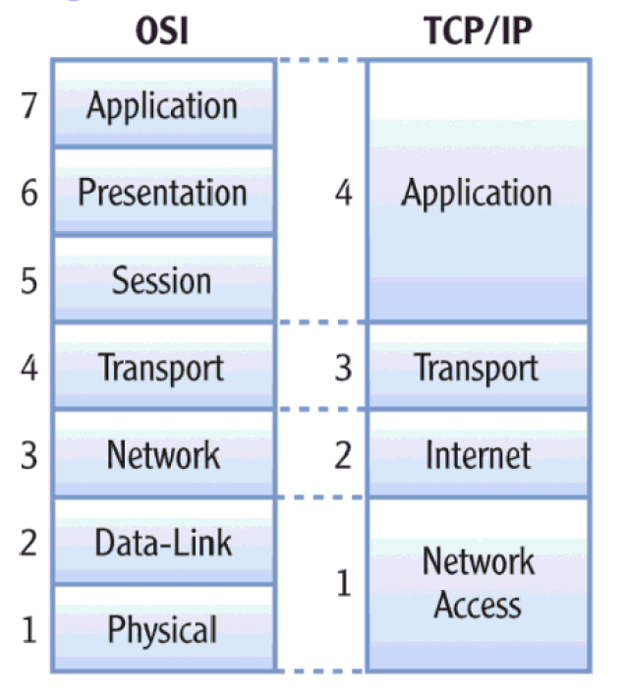
OSI versus TCP/IP

Slide 63
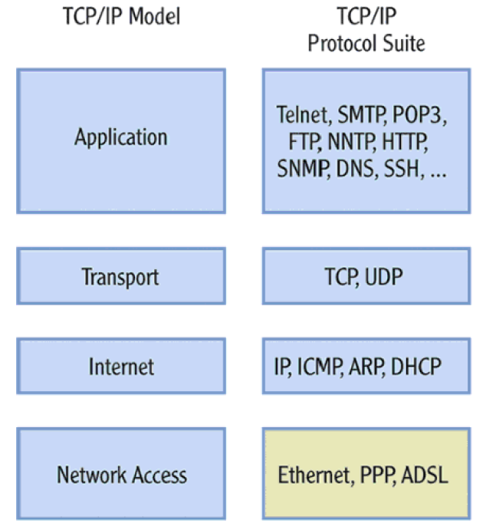
Protocols within Each TCP/IP Layer

Slide 64
Transport Layer Protocols
Transmission Control Protocol (TCP)
Reliable protocol
Guaranteed delivery
Uses connections, acknowledgements
Used for text-based data
User Datagram Protocol (UDP)
Unreliable protocol
No guarantee of delivery
No connections, no acknowledgements
Useful for audio, video or wherever we need speed but not guarantee

Slide 65
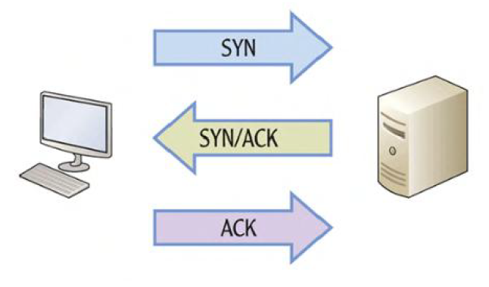
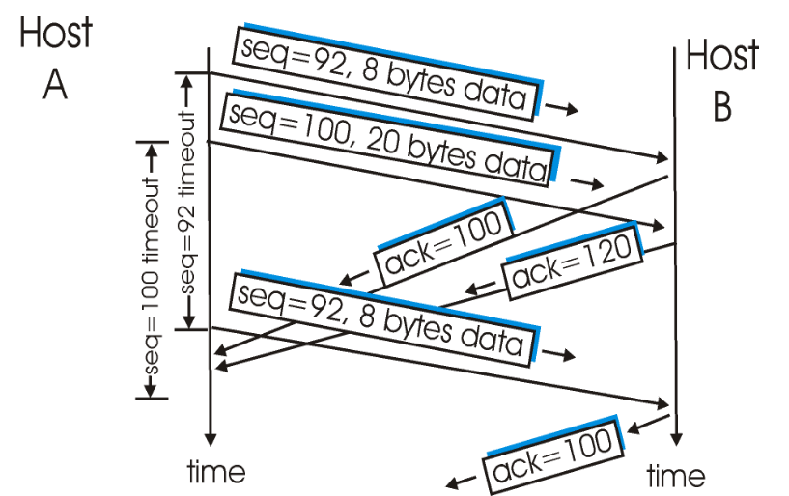
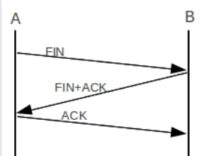
TCP – Connection Management
Connection establishment
Data transfer
Connection termination

Slide 66
UDP
No connection
No acknowledgement
No retransmissions in the case of errors

Slide 67
Internet Layer
Provides logical addressing (IP addresses)
Performs routing
Provides an IP datagram format (See next slide)

Slide 68
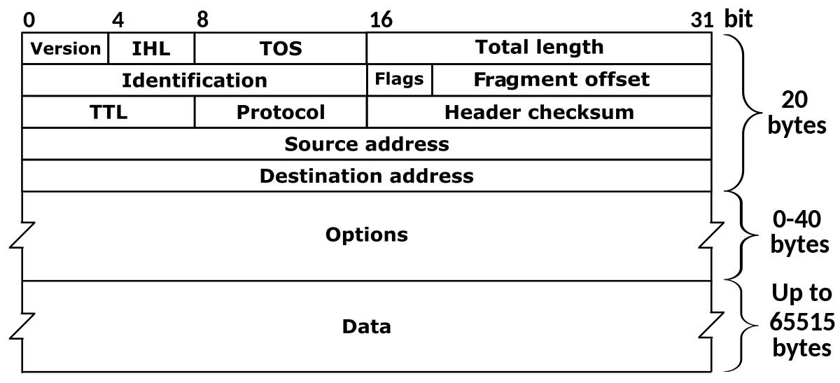
IP Datagram Format

Slide 69
Session 8-10: Network Devices – Hub, Switch, and Router

Slide 70
Networking devices
Inside a network
Hub: Older device
Switch: Modern device
To connect different networks
Router

Slide 71
Hub
Earlier, hubs were used as connection devices in Ethernet
Hub is a dumb device, works only at the physical layer (Layer 1).
So, it does not know about MAC addresses, and hence floods out all the ports.
Hub operates only in half duplex mode
Attached hosts cannot send and receive data at the same time – they can perform only one of the tasks
All devices in a hub share the same collision domain – If two or more devices transmit at the same time, collisions will occur, leading to CSMA/CD

Slide 72
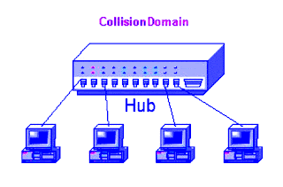
Collision domain concept
All devices that use the same physical media and listen to each frame are considered to be in the same collision domain.
This means that only one device can transmit at any given time, and any other device on the network segment must synchronize with the signal and extract the frame.

Slide 73
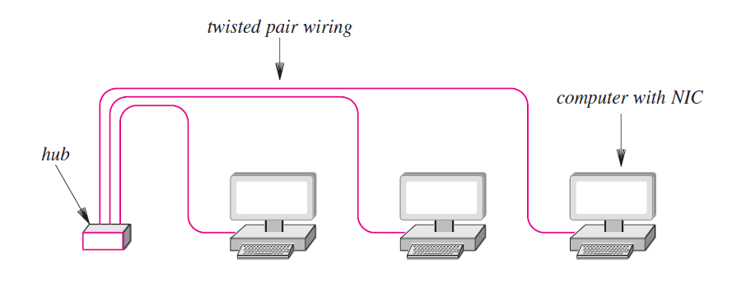
Hub

Slide 74
Switch
Hubs are obsolete
Switch is an intelligent device – can filter traffic
Example
If a hub connects two branches of a network, it will flood both the branches for every received frame
A switch will check whether it should send it to the other branch of the network by comparing addresses, as discussed shortly

Slide 75
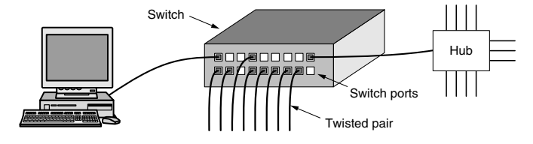
More on Switch
From the outside, a switch looks just like a hub.
They are both boxes, typically with 4 to 48 ports, each with a standard RJ-45 connector for a twisted-pair cable.
If the switch itself fails, it will need to be replaced.

Slide 76
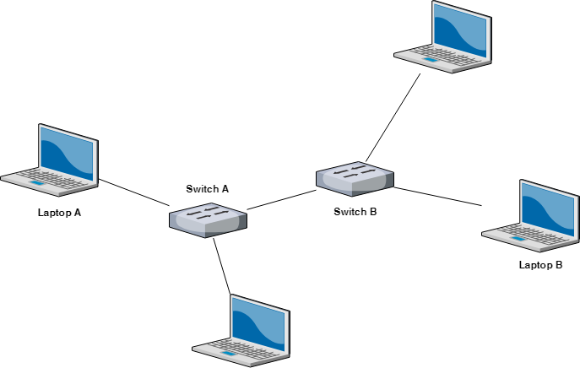
Multiple switches are used these days (Not hubs) …

Slide 77
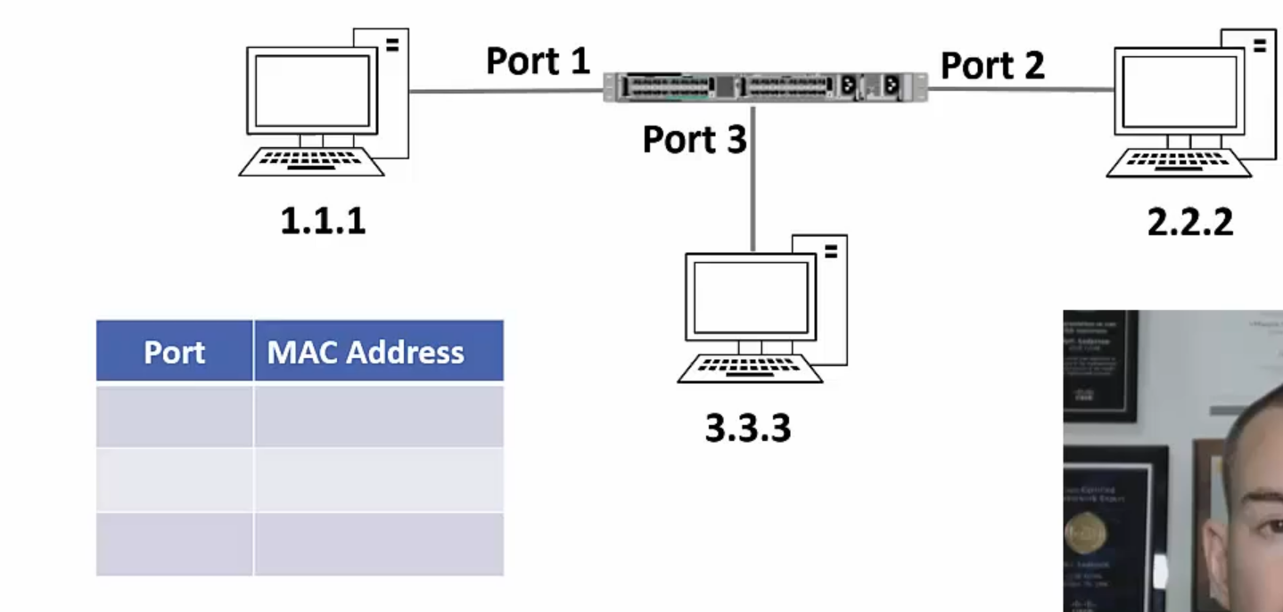
Switching Example – 1
Each switch maintains a mapping table

Slide 78
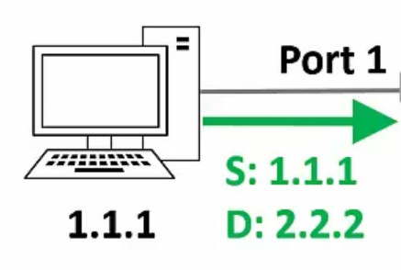
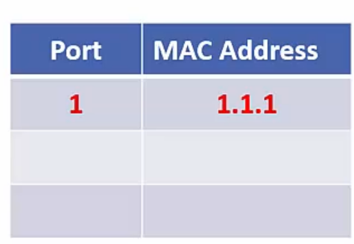
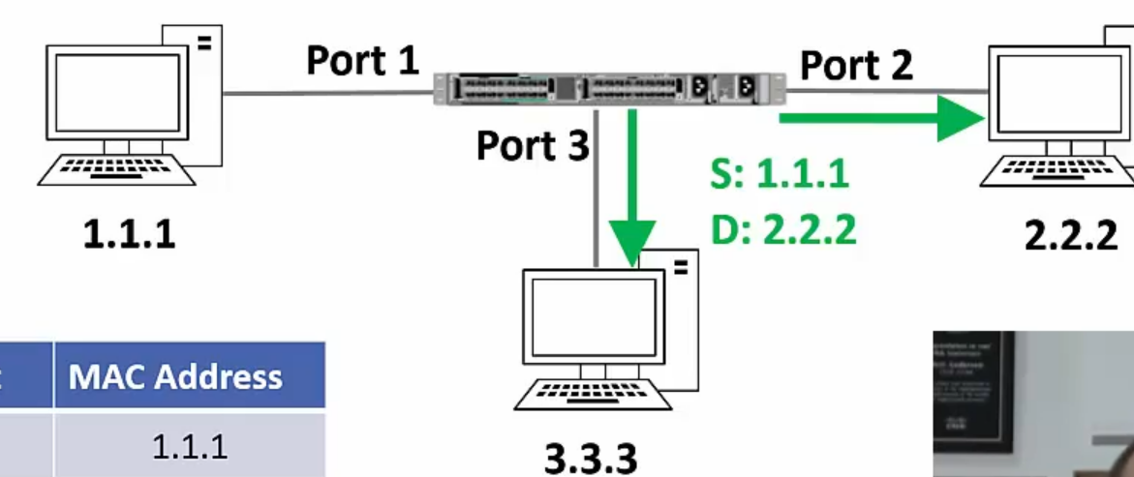
Switching Example – 2
Host 1.1.1 sends a frame to host 2.2.2
Switch sees the frame and updates its mapping table
The switch does not know where 2.2.2 is, so it floods out the frame
`

Slide 79
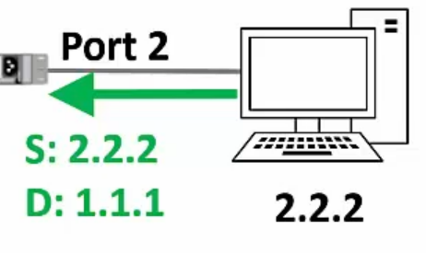
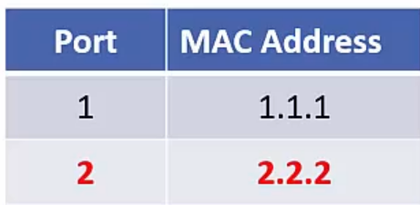
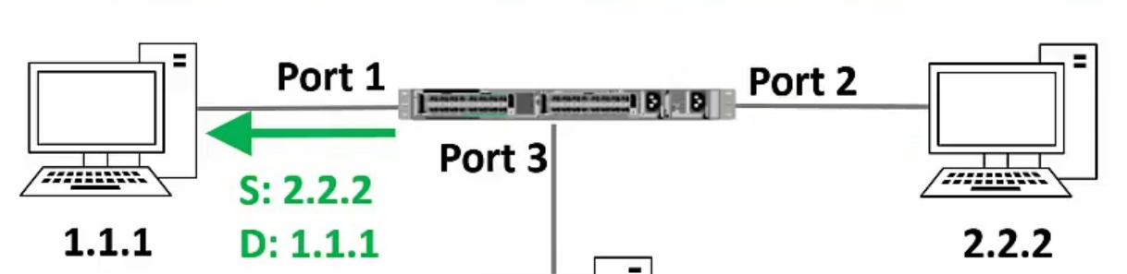
Switching Example – 3
Suppose host 2.2.2 sends a reply to 1.1.1
Switch sees the frame and updates its mapping table
The switch will send the frame only to 1.1.1

Slide 80
“Layer 2” Switch
In OSI, data link layer is layer 2 from the bottom
A switch operates at the data link layer
Hence, sometimes it is also called as Layer 2 switch

Slide 81

Router
Routers know the paths to get to the different IP subnets on network
They are required to send traffic from one subnet to another
They are also required to send traffic from one network to another
Routers operate at Layer 3 of the OSI model (network layer)

Slide 82
Routers versus Switches
Routers are Layer 3 aware and can route traffic between different networks
Switches are Layer 2 aware and can switch traffic between hosts on the same LAN
Routers support many types of interfaces, such as Ethernet, Serial ISDN, ADSL etc
Switches typically only support Ethernet interfaces
Switches will typically have more ports than routers

Slide 83

Switch Operation

Slide 84

Router Operation

Slide 85


Understanding Routing
Consider a passenger traveling from Pune to Sioux Falls, USA
Pune
Mumbai
San Francisco
Chicago
Sioux Falls
Hop Number | From | To | Passenger’s View
1 | Pune | Mumbai | Pune-Sioux Falls
2 | Mumbai | San Francisco | Pune-Sioux Falls
3 | San Francisco | Chicago | Pune-Sioux Falls
4 | Chicago | Sioux Falls | Pune-Sioux Falls

Slide 86



Understanding Routing
Consider a datagram/packet going from computer A to computer B
A
R1
R2
R3
B
 | Data Link Layer | View
Hop Number | From | To | IP View
1 | A | R1 | A-B
2 | R1 | R2 | A-B
3 | R2 | R3 | A-B
4 | R3 | B | A-B

Slide 87

MAC Addresses and LAN

Slide 88

IP Addresses and the Internet

Slide 89
Address Resolution Protocol (ARP)
Takes IP address of a computer as input and finds the MAC address of that computer
Useful to deliver the data to a particular MAC address

Slide 90

ARP Example

Slide 91
Internet Message Control Protocol (ICMP)
IP is
Connectionless
Unreliable
Unacknowledged
Datagrams are sent over the Internet with no prior connection, no assurance of delivery, and no acknowledgement if they reach the destination successfully
What happens if a router must discard a datagram because it cannot find a router to the final destination, or because the time-to-live field has a zero value?
What happens if the final destination host must discard all fragments of a datagram because it has not received all fragments within a predetermined time limit?
The Internet Control Message Protocol (ICMP) helps IP

Slide 92
ICMP Message Types
Error-reporting messages
Report problems that a router or a host (destination) may encounter when it processes an IP packet
Query messages
Occur in pairs, help a host or a network manager get specific information from a router or another host.
For example, nodes can discover their neighbors.
Also, hosts can discover and learn about routers on their network and routers can help a node redirect its messages.

Slide 93

ICMP Messages
Notes:
93

Slide 94

ICMP Message Format
Has a 8-byte header and variable-size data section
General format of the header is different for each message type, the first 4 bytes are common to all
Defines the type of the message
Specifies the reason for the specific message type
Carries information for finding the original packet that had error

Slide 95

Example: Destination Unreachable
When a router cannot route an IP datagram, it sends this message
Notes:
95

Slide 96
Destination Unreachable – Sample ‘Code’ field Values
Code 0: Network is unreachable
Code 1: Host is unreachable
Code 2: Protocol is unreachable (e.g. TCP is not running on the destination)
Code 3: Port is not reachable
Code 4: Fragmentation is needed, but “Do not fragment” field is set
Code 6: Destination network is unknown
Code 7: Destination host does not exist
Notes:
96

Slide 97
Dynamic Host Configuration Protocol (DHCP)
Need for DHCP
Computers have permanent MAC addresses, but generally dynamic IP addresses
Static IP addresses need to be manually configured by the administrator
Example: People using their own devices, mobile phones needing Internet connectivity, Accessing the Internet at home and in the office
DHCP concept
An organization or the network service provider sets up a DHCP server
A device needing an IP address contacts the server, and asks for an IP address
The server allocates an IP address to the computer for a specific duration

Slide 98

DHCP Flow

Slide 99
Sessions 6 and 7: IP Addressing and Routing

Slide 100
IP Address
An IP address has two parts:
Network Id: Identifies which network it belongs to
Host Id: On a given network, what is the host number
Examples:
This notation is called as dotted decimal notation
Some portion of the network id is reserved to indicate class of IP address
Hence, this is called as classful addressing
14.22.130.89
143.1.99.204
193.56. 78.21

Slide 101

Classful Addressing

Slide 102
Classes – How to Determine/Remember? – Three Techniques
Look at the first few bits of the binary value of the network id
First bit 0: Class A
First two bits 10: class B
First three bits 110: class C
Look at the first decimal octet/byte value of the network id
0-127: Class A
128-191: Class B
192-223: Class C
Use the flow-chart on the following slide

Slide 103
Determining Class
First bit = 0?
Yes
Class A address
No
Second bit = 0?
Yes
Class B address
No
Third bit = 0?
Yes
Class C address
No
Fourth bit = 0?
Yes
Class D address
No
Class E address
Notes:
103

Slide 104

Dotted Decimal Notation

Slide 105

Another View

Slide 106
IP Addresses Allocation to Classes
Notes:
106

Slide 107
Exercise
How many addresses can each of the classes have?
Notes:
107

Slide 108
Addresses Per Class
Class | Number of Addresses | Percentage
A | 20 Lakh | 50%
B | 10 Lakh | 25%
C | 5 Lakh | 12.5%
D | 2.5 Lakh | 6.25%
E | 2.5 Lakh | 6.25%
Notes:
108

Slide 109
Exercise
Find the class of the following addresses
227.12.14.87
193.14.56.22
14.23.120.8
252.5.15.111
134.11.78.56
Notes:
109

Slide 110
Determining Class Based on an IP Address
Class | Contents of First Byte (Last three are not shown)
A | 1 to 126 (0 and 127 are reserved)
B | 128 to 191
C | 192 to 223
D | 224 to 239
E | 240 to 255
Notes:
110

Slide 111
Masking
Given the IP address of a host, can we find its network address?
“Masking” concept: AND the complete IP address with a “Mask”, result is the network address
Notes:
111

Slide 112
Masking concept
If IP address is 134.45.78.2, network ID is 134.45
An address in the block
AND
Network portion of the IP address
Mask
Notes:
112

Slide 113
Masking Example
If IP address is 134.45.78.2, network ID is 134.45 (See next slide)
134.45.78.2
AND
134.45
255.255.0.0
Notes:
113

Slide 114
Calculation
The address whose network ID we want
134.45.78.2
Default mask for class B (since the address above is from class B)
AND
255.255.0.0
Network ID for the address
134.45.0.0

Slide 115

Default Mask

Slide 116
Default Masks
Class | Mask in Binary | Mask in dotted-decimal
A | 11111111 00000000 00000000 00000000 | 255.0.0.0
B | 11111111 11111111 00000000 00000000 | 255.255.0.0
C | 11111111 11111111 11111111 00000000 | 255.255.255.0
Notes:
116

Slide 117
Masking Examples
Given an IP address of 23.56.7.91, find the network address.
Given an IP address of 132.6.17.85, find the network address.
Notes:
117

Slide 118
Private/Local/Internal IP Addresses
The following ranges of IP addresses are reserved as private/local/internal IP addresses, and they cannot be assigned to a computer on the Internet as a public/external IP address
Class A: 10.0.0.0 to 10.255.255.255
Class B: 172.16.0.0 to 172.31.255.255
Class C: 192.168.0.0 to 192.168.255.255

Slide 119
Subnetting
Notes:
119

Slide 120

Subnetting Concept

Slide 121
Subnet Concept
Network id
Host id
Two ways to address a particular house
Building number, House number (Normal IP address)
Building number, Floor number, House number (IP address with subnet)
Subnet id
Network id
Host id
Notes:
121

Slide 122
Subnetting
Divide a network into smaller sub-networks with each subnet having its own IP address
Allow a network to be split into several internal sub-networks, but act like a single network to the outside world
Motivation: Make better use of the IP address space
IP addresses: Two levels of hierarchy; subnetting makes it three
Notes:
122

Slide 123

Subnetting Example
Consider a network having IP address 200.1.2.0
We want to divide this into two parts, creating two subnets
Analysis: Network belongs to class C

Slide 124
Subnetting Example
We want to create two subnets
Subnet 1 will have id 0₂
Subnet 2 will have id 1₂
IP address length is always 32 bits
For the current example, we have:
Net id: 24 bits
Host id: 8 bits
We need one bit for the subnet id: From where to take, and why?

Slide 125
Subnetting Example
If we take 1 bit from the net ID
Net id will become 23 bit
What will be the impact?
Current net ID is:
Which bit to take?
Suppose we take the last bit in the third octet (i.e. 0)
Now net ID will become 200.1.1 (because last octet will now be of only 7 bits 0000001)
Suppose we take the first bit in the first octet (i.e. 1)
Now net ID will become 72.1.1 (because first octet will now be of only 7 bits 1001000)
Conclusion: We cannot touch the net ID
200 | 1 | 2
11001000 | 00000001 | 00000010

Slide 126

Subnetting Example
Conclusion: We must take one bit from the host id
This bit must be from the leftmost part of the host id
Now, the host id will only have 7 bits
If borrowed bit = 0, then it represents the first subnet
If borrowed bit = 1, then it represents the second subnet

Slide 127

Resulting Subnets
IP addresses of the two subnets:
200.1.2.00000000 = 200.1.2.0
200.1.2.10000000 = 200.1.2.128

Slide 128
Subnet 1
Network address of the subnet = 200.1.2.0
Total number of IP Addresses = 2⁷ = 128
Total number of hosts that can be configured = 128 – 2 = 126
Range of IP Addresses = [200.1.2.00000000, 200.1.2.01111111] = [200.1.2.0, 200.1.2.127]
Broadcast Address = 200.1.2.01111111 = 200.1.2.127

Slide 129
Subnet 2
Network address of the subnet = 200.1.2.128
Total number of IP Addresses = 2⁷ = 128
Total number of hosts that can be configured = 128 – 2 = 126
Range of IP Addresses = [200.1.2.10000000, 200.1.2.11111111] = [200.1.2.128, 200.1.2.255]
Direct Broadcast Address = 200.1.2.11111111 = 200.1.2.255

Slide 130
Exercise
Consider that we have a single network having IP Address 200.1.2.0
We want to do subnetting and divide this network into 4 subnets

Slide 131


Solution
The network belongs to class C
To create 4 subnets, we need 2 bits from the host id to be used as subnet id
Host id will now have 6 bits
Subnet IDs
Subnet ID 1: 00
Subnet ID 2: 01
Subnet ID 3: 10
Subnet ID 4: 11

Slide 132

Solution
IP addresses of the four subnets
200.1.2.00000000 = 200.1.2.0
200.1.2.01000000 = 200.1.2.64
200.1.2.10000000 = 200.1.2.128
200.1.2.11000000 = 200.1.2.192

Slide 133
Subnet 1
Network Address of the subnet = 200.1.2.0
Total number of IP Addresses = 2⁶ = 64
Total number of hosts that can be configured = 64 – 2 = 62
Range of IP Addresses = [200.1.2.00000000, 200.1.2.00111111] = [200.1.2.0, 200.1.2.63]
Broadcast Address = 200.1.2.00111111 = 200.1.2.63

Slide 134
Subnet 2
Network Address of the subnet = 200.1.2.64
Total number of IP Addresses = 2⁶ = 64
Total number of hosts that can be configured = 64 – 2 = 62
Range of IP Addresses = [200.1.2.01000000, 200.1.2.01111111] = [200.1.2.64, 200.1.2.127]
Broadcast Address = 200.1.2.01111111 = 200.1.2.127

Slide 135
Subnet 3
Network Address of the subnet = 200.1.2.128
Total number of IP Addresses = 2⁶ = 64
Total number of hosts that can be configured = 64 – 2 = 62
Range of IP Addresses = [200.1.2.10000000, 200.1.2.10111111] = [200.1.2.128, 200.1.2.191]
Broadcast Address = 200.1.2.10111111 = 200.1.2.191

Slide 136
Subnet 4
Network Address of the subnet = 200.1.2.192
Total number of IP Addresses = 2⁶ = 64
Total number of hosts that can be configured = 64 – 2 = 62
Range of IP Addresses = [200.1.2.11000000, 200.1.2.11111111] = [200.1.2.192, 200.1.2.255]
Broadcast Address = 200.1.2.11111111 = 200.1.2.255

Slide 137
Subnetting Exercise
For an address 192.168.5.85 /24, we want to create 5 subnets.
What will be the first host address on the first subnet and the second host address on the second subnet?
How many hosts are possible per subnet?

Slide 138
Solution
Our network address is 192.168.5.85 /24.
We want to create 5 subnets. So, 3 bits from the host id portion will be used for the subnet id. So, 5 bits will be left for the host id.
First subnet id in binary will be: 000
First address possible in the first subnet will be: 00000. But this is not the first host address, as this is reserved as the first subnet address.
So, the first host address within the first subnet will be 00001.
The first host address within the first subnet will be:
192.168.5.(000 00001) to the base 2
192.168.5.1 - First host address in the first subnet
The second host address within the second subnet will be:
192.168.5.(001 00010) to the base 2
192.168.5.34
Number of hosts per subnet = 2^{h} – 2 = 2⁵ – 2 = 30

Slide 139
Subnetting Exercise – 3
Consider a class C network with IP address 198.34.5.0.
You are asked to create 6 subnets.

Slide 140
Solution
(1) Write the default mask in decimal.
=> 24 bits are reserved for the network id, 8 bits are reserved for the host id
So, the default mask will be 255.255.255.0
(2) Write the subnet mask in decimal.
=> We want to create 6 subnets. For 6 subnets, we will need to reserve 3 bits for the subnet id (because 2 to the power 3 = 8, which is >= 6)
As we know, the default mask is 255.255.255.0 in decimal
In binary, it will be 11111111.11111111.11111111.00000000
Subnet mask will be: 11111111.11111111.11111111.11100000
Subnet mask in decimal will be: 255.255.255.224
(3) Write the subnetted address for this network.
=> Default network address for this network is 198.34.5.0/24.
Subnetted address for the same network will be 198.34.5.224/27.
(4) What will be the first host address of the first subnet in this network?
=>
There are 6 subnets.
3 bits are reserved for the subnet id.
Subnet ids will be:
First subnet id: 000
Second subnet id: 001
Third subnet id: 010
...
Eigthth subnet id: 111
From above, the first subnet id is 000.
Within this first subnet, the first possible address is 00000
However, the first address is any network or in any subnet is reserved as the network address.
Thus, the first host address will be 00001.
Thus, the full address for the first host in the first subnet will be 00000001 in binary, or 1 in decimal.
And its complete IP address will be 198.34.5.1/27.
(5) How many hosts are possible in the third subnet? What will be the network address for the third subnet, what will be the first host address for the third subnet, and what will be the last host address for the third subnet?

Slide 141
Subnetting Exercise – 4
What are the network address, broadcast address, and valid host addresses for the IP address 198.22.45.173/26?
What is the subnet mask in dotted decimal notation?

Slide 142
Solution
Let’s figure out the subnet mask in dotted decimal notation first because that’s easy...
/26 borrows the first 2 bits in the last octet
128 + 64 = 192
So the subnet mask is 255.255.255.192

Slide 143
Solution - Subnets and Hosts
Our given address is 198.22.45.173/26
Since two bits are reserved for the subnet id, 4 subnets 00, 01, 10, and 11 are possible
We need to think “Our IP address will fall in which of these four subnets?”
To answer this, let us calculate the address range for each of the four subnets

Slide 144
Solution - Subnets and Hosts
Subnet Number (Decimal) | Subnet ID (Binary) | First full address in the subnet (Binary) | Last full address in the subnet (Decimal) | First full address in the subnet (Binary) | Last full address in the subnet (Decimal) | Our target IP address (173)
1 | 00 | 00000000 | 00111111 | 0 | 63 | Not here
2 | 01 | 01000000 | 01111111 | 64 | 127 | Not here
3 | 10 | 10000000 | 10111111 | 128 | 191 | Here
4 | 11 | 11000000 | 11111111 | 192 | 255 | Not here
Our given address is 198.22.45.173/26

Slide 145
Solution
Next let’s calculate the address range for this subnet
The network portion of the address is the first 26 bits
198.22.45.128 is the network address (First address of the third subnet – See the previous slide)
The line is after 64, so add 64 to get the network address of the next subnet
The next subnet begins at 198.22.45.192
So the broadcast address is 198.22.45.191
And the valid host addresses are 198.22.45.129 to 198.22.45.190

Slide 146

Summary: Subnetting in Class C

Slide 147
Variable Length Subnet Mask (VLSM)

Slide 148
VLSM Concept
Early routing protocols only supported Fixed Length Subnet Masking (FLSM) where all subnets had to be the same size.
You couldn’t have a subnet with 14 hosts and another subnet with 64 hosts in the same network.
All modern routing protocols support Variable Length Subnet Masking (VLSM).
This allows us to size subnets differently according to how many hosts they have.

Slide 149
VLSM Considerations
How many locations do we have in the network?
How many hosts are in each location?
What are the IP addressing requirements for each location? (Should different departments or types of host be in different subnets?)
What size is appropriate for each subnet? (Don’t waste addresses, but leave room for growth.)

Slide 150
VLSM Example
Suppose there is an administrator that has four departments to manage.
These are sales and purchase department with 120 computers, development department with 50 computers, accounts department with 26 computers and management department with 5 computers.
If the administrator has IP 192.168.1.0/24, how can department wise IPs be allocated?

Slide 151

Variable Length Subnet Mask (VLSM)
Step 1: For each segment select the block size that is >= the actual requirement. Make a list of subnets possible:

Slide 152

Variable Length Subnet Mask (VLSM)
Step 2: Arrange all the segments in descending order based on the block size that is from highest to lowest requirement:

Slide 153
Variable Length Subnet Mask (VLSM)
Step 3: The highest IP available has to be allocated to highest requirement, so the sales and purchase department gets 192.168.1.0/25, which has 126 valid addresses that can easily be available for 120 hosts. The subnet mask used is 255.255.255.128.
Network address: 192.168.1.0
Host range: 192.168.1.1 – 192.168.1.126
Broadcast address: 192.168.1.

Slide 154
Variable Length Subnet Mask (VLSM)
Step 4: The next segment (Development) requires an IP to handle 50 hosts. We need /26 for 62 hosts. The subnet mask used is 255.255.255.192.
Network address: 192.168.1.128
Host range: 192.168.1.129 – 192.168.1.190
Broadcast address: 192.168.1.191

Slide 155
Variable Length Subnet Mask (VLSM)
Step 5: Accounts needs 26 hosts. We will need /27, as it has 30 valid hosts. The mask used is 255.255.255.224.
Network address: 192.168.1.192
Host range: 192.168.1.193 – 193.168.1.222
Broadcast address: 192.168.1.223

Slide 156
Variable Length Subnet Mask (VLSM)
Step 6: The last segment (Management) requires 5 valid hosts IP, which means /29. Subnet mask is 255.255.255.248
Network address: 192.168.1.224
Host range: 192.168.1.225 to 192.168.1.230
Broadcast address: 192.168.1.231

Slide 157

Summary

Slide 158

VLSM Example

Slide 159
VLSM Example – Design Steps
Find the largest segment and allocate a suitable subnet size for it.
Allocate this subnet at the start of the address space.
Continue going down the list.

Slide 160
VLSM Example – Design Steps
The Engineering departments in both sites have 28 hosts.
For our example we’ve been told that the departments will not grow and we need to use the smallest subnets possible to maximise our address space.
Calculate the optimal subnet mask for the Engineering departments.
Also determine the network and broadcast addresses that will be allocated to both Engineering departments, and the range of host addresses.

Slide 161

Engineering Departments
We’ve been allocated 200.15.10.0/24

Slide 162
New York Sales Department
The next largest subnet is New York Sales which requires 14 hosts.
Calculate the optimal subnet mask.
Also determine the network and broadcast addresses that we will allocate, and the range of host addresses.

Slide 163

New York Sales Department
We’ve been allocated 200.15.10.0/24
New York Sales Department
We’ve been allocated 200.15.10.0/24
/28 (or 255.255.255.240) supports 14 hosts
200.15.10.0 to 200.15.10.63 are already in use by the Engineering departments, so this network address will start at 200.15.10.64
The network address goes up in values of 16, so the next one is 200.15.10.80
Our broadcast address is 200.15.10.79
Valid host addresses are 200.15.10.65 to 200.15.10.78

Slide 164
Boston Sales Department
The next largest subnet is Boston Sales which requires 7 hosts.
Calculate the optimal subnet mask.
Also determine the network and broadcast addresses that we will allocate, and the range of host addresses.

Slide 165

Boston Sales Department
We’ve been allocated 200.15.10.0/24
/28 (or 255.255.255.240) supports 14 hosts
/29 does not support 8 hosts! Remember to subtract 2 for the network and broadcast address
200.15.10.0 to 200.15.10.79 are already in use, so this network address will start at 200.15.10.80
The network address goes up in values of 16, so the next one is 200.15.10.96
Our broadcast address is 200.15.10.95
Valid host addresses are 200.15.10.81 to 200.15.10.94

Slide 166
Are we done?
Don’t forget the links between routers

Slide 167
New York to Boston Link
The last subnet is the link between the New York and Boston routers.
Calculate the optimal subnet mask.
Also determine the network and broadcast addresses that we will allocate, and the range of host addresses.

Slide 168

New York to Boston Link
We’ve been allocated 200.15.10.0/24
/30 (or 255.255.255.252) supports 2 hosts
200.15.10.0 to 200.15.10.95 are already in use, so our network address will be 200.15.10.96
The network address goes up in values of 4, so the next one is 200.15.10.100
Our broadcast address is 200.15.10.99
Valid host addresses are 200.15.10.97 to 200.15.10.98

Slide 169

Summary

Slide 170

Original Network Diagram

Slide 171

Diagram with Network Topology

Slide 172

VLSM Problem
Create VLSM
IP address: 205.15.43.0/24

Slide 173
Solution
We have 6 networks: LAN1 – LAN2 – LAN3 – WAN link1 – WAN link2 – WAN link3
Order the networks from the largest size to the smallest:
1) LAN2 (50 hosts)
2) LAN1 (24 hosts)
3) LAN3 (8 hosts)
4) WAN link 1 - WAN link 2 - WAN link 3 (2 hosts each)

Slide 174
LAN2
Needs 50 hosts, so we will need to use /26 (will give 62 hosts)
Subnet mask: 255.255.255.192
Network address: 205.15.43.0
Host range: 205.15.43.1 - 205.15.43.62
Broadcast address: 205.15.43.63

Slide 175
LAN1
Needs 24 hosts, so we will need to use /27 (will give 30 hosts)
Subnet mask: 255.255.255.224
Network address: 205.15.43.64
Host range: 205.15.43.65 - 205.15.43.94
Broadcast address: 205.15.43.95

Slide 176
LAN3
Needs 8 hosts, so we will need to use /28 (will give 14 hosts)
Subnet mask: 255.255.255.240
Network address: 205.15.43.96
Host range: 205.15.43.97 - 205.15.43.110
Broadcast address: 205.15.43.111

Slide 177
WAN Link1
Needs 2 hosts, so we will need to use /30 (will give 2 hosts)
Subnet mask: 255.255.255.252
Network address: 205.15.43.112
Host range: 205.15.43.113 - 205.15.43.114
Broadcast address: 205.15.43.115

Slide 178
WAN Link2
Needs 2 hosts, so we will need to use /30 (will give 2 hosts)
Subnet mask: 255.255.255.252
Network address: 205.15.43.116
Host range: 205.15.43.117 - 205.15.43.118
Broadcast address: 205.15.43.119

Slide 179
WAN Link3
Needs 2 hosts, so we will need to use /30 (will give 2 hosts)
Subnet mask: 255.255.255.252
Network address: 205.15.43.120
Host range: 205.15.43.121 - 205.15.43.122
Broadcast address: 205.15.43.123

Slide 180

Summary

Slide 181
Classless Inter Domain Routing (CIDR)

Slide 182
Problem CIDR Solves
Traditional IP addressing is classful
Available host IP addresses in each class make class C almost unusable, putting great pressure on class A and B:
Class A - Over 16 million host identifiers
Class B - 65,535 host identifiers
Class C - 254 host identifiers
Classful addressing: If a company has more than 254 hosts, it cannot use a class C network, but a class B network would give 65,534 hosts, which was too big! – Result waste of IP address space
Classless Inter Domain Routing (CIDR) uses Variable Length Subnet Mask (VLSM) concept, so it allows subnet masks of variable lengths
A CIDR IP address is classless
Now we can allocate IP address blocks as per the needs (and not as per the class limitations, as mentioned above)

Slide 183
CIDR Notation
Format: a.b.c.d/n
Here, n = mask or number of bits representing the network id
Example of a CIDR address: 200.10.20.40/28
This is called as the slash notation
Now network id is called as prefix and host id is called as suffix
In the above example, 28 bits represent the network id and 4 bits represent the host id, so 2⁴ - 2 = 14 hosts are possible
Binary mask will be 11111111.11111111.11111111.11110000, decimal mask will be 255.255.255.240
Network id Host id
Prefix Suffix

Slide 184
CIDR: Finding Network Id
Consider a CIDR address 200.10.20.40/28
Writing the last octet in binary: 200.10.20.00100010/28
Since the slash notation is /28, the first four bits of the last octet are a also part of the prefix – we must not touch them
So, in CIDR:
The network address will be 200.10.20.00100000/28 and in decimal it will be 200.10.20.32/28
The broadcast address will be 200.10.20.00101111/28 and in decimal it will be 200.10.20.47/28
The host range is 200.10.20.33/28 to 200.10.20.46 (14 hosts)

Slide 185
Rules for CIDR
Addresses should be contiguous
Number of addresses in a block must be power of 2
First address of any block must be evenly divisible by the size of the block

Slide 186
Example
Is a block of IP addresses 100.1.2.32/28 to 100.1.2.47/28 a valid IP address block?
All the IP addresses are contiguous.
Total number of IP addresses in the Block = 16 = 2⁴.
1st IP address: 100.1.2.00100000/28. Since Host Id will contains last 4 bits and all the least significant 4 bits are zero; the first IP address is evenly divisible by the size of the block.
All three rules are followed by this Block. Hence, it is a valid IP address block.

Slide 187
Tricky Problem
Do the following two IP addresses belong to the same physical network?
192.168.200.5/30 and 192.168.200.9/30

Slide 188
Solution
First IP address
Address: 192.168.200.5/30 11000000.10101000.11001000.00000101
Netmask: 255.255.255.252 11111111.11111111.11111111.11111100
4 addresses are possible, including network address and broadcast address
Network: 192.168.200.4/30 11000000.10101000.11001000.00000100
Broadcast: 192.168.200.7 11000000.10101000.11001000.00000111
Host 1: 192.168.200.5 11000000.10101000.11001000.00000101
Host 2: 192.168.200.6 11000000.10101000.11001000.00000110
Hosts/Net: 2

Slide 189
Solution
Second IP address
Address: 192.168.200.9/30 11000000.10101000.11001000.00001001
Netmask: 255.255.255.252 11111111.11111111.11111111.11111100
4 host address are possible, including network address and broadcast address
Network: 192.168.200.8/30 11000000.10101000.11001000.00001000
Broadcast: 192.168.200.11 11000000.10101000.11001000.00001011
Host 1: 192.168.200.9 11000000.10101000.11001000.00001001
Host 2: 192.168.200.10 11000000.10101000.11001000.00001010
Hosts/Net: 2

Slide 190
Conclusion
Hosts 192.168.200.5/30 and 192.168.200.9/30 have the same suffix, and yet they do not belong to the same physical network

Slide 191
CIDR, Route Aggregation and Supernetting
Supernetting is the process of summarizing a number of contiguous subnetted networks back in a single large network
This process is also known as route summarization or route aggregation
Supernetting is mainly done for optimizing the routing tables
Without supernetting, a router will share information about all the routes in its routing table with the other routers
With supernetting, it will summarize them before sharing
Route summarization reduces the size of routing updates dramatically

Slide 192

Supernetting Example – 8 Subnets Summarized Into One

Slide 193

Route Summarization Example

Slide 194
Router and Routing

Slide 195


Routing: Key Aspects
Routing table
Routing algorithms

Slide 196
How Routers Learn about Routes?
Default routing
All routes send packets to a single router
Static routing
We manually add routes to the routing tables
Dynamic routing
Routers learn about routes from each other or because of broadcasts

Slide 197

Interior and Exterior Gateway Protocols

Slide 198
Classes of Routing Protocols
Distance Vector Protocols (Example: RIP – Routing Information Protocol)
Use distance to measure the route cost
The number of hops between the router and a destination network establishes the distance
Regularly send their whole routing table to the remote routers
The receiving router then integrates its routing table with the received data based on the metrics
Link State Protocols (Example: OSPF – Open Shortest Path First)
Form a remote connection with other routers prior to sharing routing data
They don’t broadcast routing data to the whole network
Path Vector Protocols (Example: BGP – Border Gateway Protocol)
Works across interior networks, i.e. in an exterior network

Slide 199
Routing Information Protocol (RIP)
RIP routers use only routing tables to store information
RIP can store multiple routes to the same destination and uses as its metric a value called hop count
Hop count is the number of routers that are in the path to the destination network using that route
Broadcasts UDP data packets to exchange routing information
Cisco software sends routing information updates every 30 seconds, which is termed advertising
If a device does not receive an update from another device for 180 seconds or more, the receiving device marks the routes served by the non updating device as unusable
If there is still no update after 240 seconds, the device removes all routing table entries for the non updating device

Slide 200

Distance Vector Routing Example – Step 1

Slide 201

Distance Vector Routing Example – Step 2

Slide 202

Distance Vector Routing Example – Step 3
More updates will be needed to fill the blanks/gaps …

Slide 203
Variations of RIP: IGRP and EIGRP
The Interior Gateway Routing Protocol (IGRP) is a distance-vector routing protocol.
IGRP has been superseded by Enhanced IGRP (EIGRP), which has many new features.
IGRP and EIGRP have a compound metric that takes into account several factors, such as link bandwidth and latency.
As such, IGRP is superior to RIP, which takes into account only the hop count, and RIPv2, which uses both hop count and bandwidth.
In addition to the compound metric, which allows better route selection, IGRP tends to have better convergence times, meaning that routing stabilizes more quickly after a network disruption.
Notes:
203

Slide 204
Drawbacks
IGRP and EIGRP are proprietary protocols, which means they are implemented only by Cisco routers.
IGRP (like RIP) broadcasts the entire routing table, which can consume a lot of network bandwidth
Notes:
204

Slide 205
IGRP versus EIGRP
EIGRP supports VLSM, IGRP does not
Path calculations are improved in EIGRP
EIGRP has less frequent updates as compared to IGRP
Notes:
205

Slide 206
OSPF
Open Shortest Path First (OSPF) is an industry-standard protocol that operates on non-Cisco routers also
Based on link-state routing
Detailed routing information about an area is confined to that area, and only a summary of information is advertised to other areas
This has the benefit of keeping OSPF routing tables smaller
RIP works fine in small networks, but not in large networks
When routers exchange information, it is called as flooding
Frequency of exchange is once in every 1-2 hours

Slide 207

OSPF Area

Slide 208
Understanding OSPF
Two aspects: OSPF tables and OSPF packets
OSPF uses three tables
Neighbor Table: Information about neighbors
Topology Table: Information about other routers and networks in the AS
Routing Table
It uses five packets
Hello Packets
Database Descriptor (DBD)
Link State Request (LSR)
Link State Update (LSU) – Most important
Link State Acknowledgement (LSAck)

Slide 209

Link State Update Packet
Main packet, used by a router to advertise the state of its links
Format

Slide 210

Link State Update – Example
What will be the LSA part of the Link State Update packet sent by router 10.24.7.9?

Slide 211

Link State Update – Example
1: It is about a router
3: It is about a network

Slide 212

Flooding into the Neighbouring Areas

Slide 213

Path Vector Routing – Step 1
Each AS has at least one path vector routing that collects reachability information for each network in that AS

Slide 214

Path Vector Routing – Step 2
A path vector routing table for each router can be created if ASs share their reachability list with each other

Slide 215
Network Address Translation (NAT)

Slide 216

Network Address Translation (NAT) Concept

Slide 217

NAT Mapping Example

Slide 218
InfiniBand Network

Slide 219
InfiniBand Network
InfiniBand is an open standard network interconnection technology with high bandwidth, low delay and high reliability
This technology is defined by IBTA (InfiniBand Trade Alliance)
This technology is widely used in HPC
Supports basic Single Data Rate (SDR) of 2.5 Gbps
Usually, four cables are used together, to geta speed of 10 Gbps
Another improvement called as Quad Data Rate (QAD) signaling takes this rate to 40 Gbps
Significant advantages over Ethernet and optical fiber

Slide 220
InfiniBand Basics
Traditionally, I/O was handled by the shared PCI bus (32 or 44 bit transfer)
In InfiniBand, the I/O is handled not by processors, but by interconnect architecture
This means that the I/O does not go to the kernel area of the operating system, but directly comes in to or goes out from the user area
Makes it very fast
Packets are of 4 KB

